Slide 1
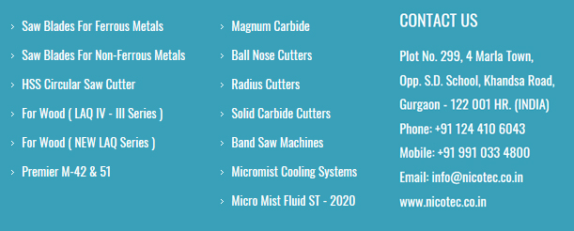

Slide 2
Nicotec Sales Corporation was established in 2010, as a commercial Tool Room to cater to the needs of local industries. Engineering industry in India then, was still in nascent stage and demand for Metal Sawing Machines was growing rapidly. Nicotec provides the quality industrial products that are second to none. It is our commitment to customer service that sets us apart from every one else. We have a world wide network that provides us the strength of sourcing best quality products from best suppliers all over the world with highly competitive prices.
Our customers, large or small, count on our ability to deliver products, information, and assistance in a timely manner. At Nicotec we are very responsive to our customer needs, which save your time and confusion, and assure the personal attention you deserve. We offer the flexibility to provide our customers with the product form they need to meet their unique specifications.
Professional competence, combined with high-quality products, has led us to our present position as one of the leading supplier of Industrial Products in the Indian market. Owing to our efficient sales organization we have become exclusive distributors of several world-renowned manufacturers of industrial consumables. We are committed to utilizing the latest advancements in technology to enhance our service, sales, and distribution efforts.
ABOUT NICOTEC

Slide 3
Nicotec is a distributor-focused company. Our objective is to provide the necessary products and services to the distribution network to improve profitability and promote growth.
Being in constant dialogue with our distributors, listening & sharing information, we are open. Listening each other enables us to constantly improve the way we respond to your local market because your customers are our customers. Nicotec believes in a strong bond with its distributors. The markets in which we operate are constantly changing. Organisations must continue to be able to satisfy the changing needs of their customers.
Our international network is based on a strong sense of community. We listen to your ideas and comments, and try to give full support on different levels. This interaction and co-operation gives us the opportunity to do better and make us and you "Always ready for things to come"..
Mission:- To be the best service provider by considering the value of lead time and at the same time committed to the customer to support their each and every touch points.
OUR FOCUS & MISSION

Slide 4
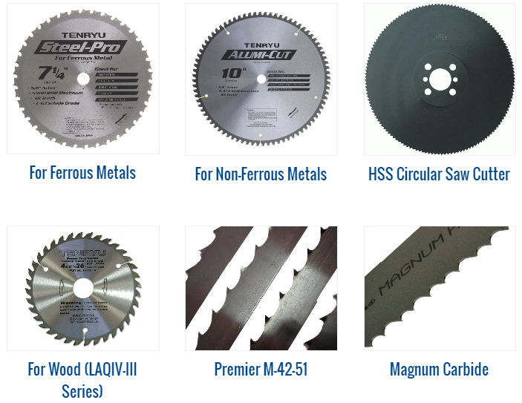
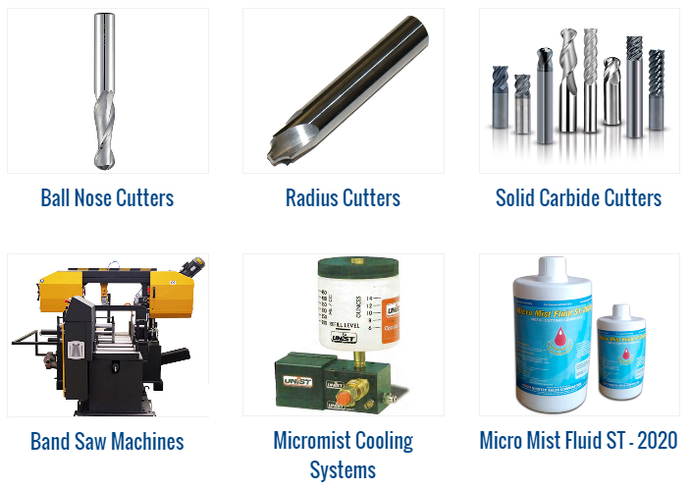
OUR PRODUCTS

Slide 5
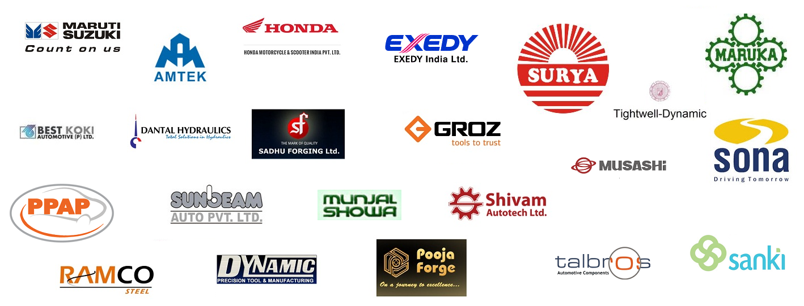
OUR CLIENTS

Slide 6
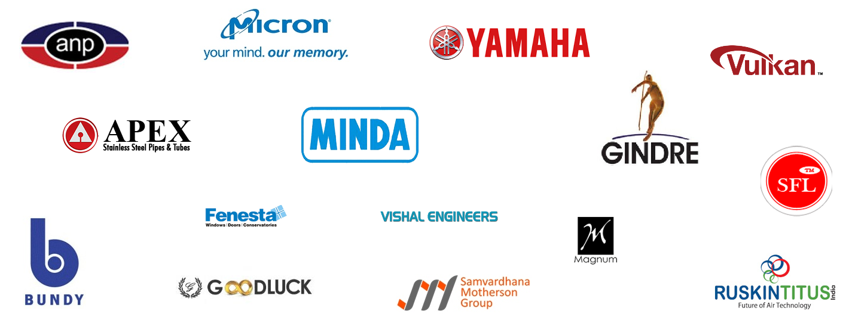
OUR CLIENTS

Slide 7
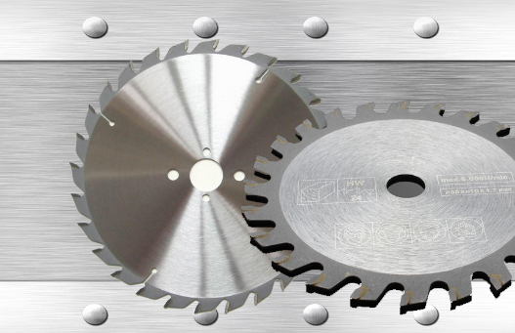
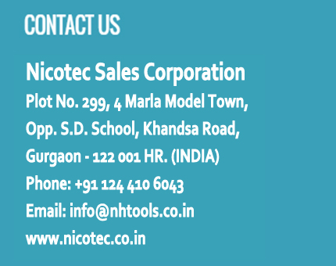
CONTACT US

Slide 8
LOOKING FORWARD FOR BUSINESS ASSOCIATION
THANK YOU

